Slide 1
Information Extraction and Named Entity Recognition
Introducing the tasks:
Getting simple structured information out of text

Slide 2
Information Extraction
Information extraction (IE) systems
Find and understand limited relevant parts of texts
Gather information from many pieces of text
Produce a structured representation of relevant information:
relations (in the database sense), a.k.a.,
a knowledge base
Goals:
Organize information so that it is useful to people
Put information in a semantically precise form that allows further inferences to be made by computer algorithms
Notes:
Now let's define information extraction! a more general task
Goal: get semantic information out of documents, esp. web pages
Defined as a dumbing-down of more lofty goal of Natural Language Understanding -- more technologically manageable
we're often interested in learning about particular relations (in DB sense)
e.g. scouring financial news for movements of executives
e.g. [person] [assumes/loses] [role] at [company]
I want to scour through text, find relation instances, suck out, put in DB
you're allowed to do domain- and problem-specific customization
lots of potential applications
- business/financial context
- biomedical context, clinical medicine
there's all this unstructured text data about research and patients -- you'd like to be able to get structured information out of it
could lead to other automated information finding: trends, correlations, drug interactions, impact of some protein on expression of a gene, ...

Slide 3
Information Extraction (IE)
IE systems extract clear, factual information
Roughly: Who did what to whom when?
E.g.,
Gathering earnings, profits, board members, headquarters, etc. from company reports
The headquarters of BHP Billiton Limited, and the global headquarters of the combined BHP Billiton Group, are located in Melbourne, Australia.
headquarters(“BHP Biliton Limited”, “Melbourne, Australia”)
Learn drug-gene product interactions from medical research literature
Notes:
Now let's define information extraction! a more general task
Goal: get semantic information out of documents, esp. web pages
Defined as a dumbing-down of more lofty goal of Natural Language Understanding -- more technologically manageable
we're often interested in learning about particular relations (in DB sense)
e.g. scouring financial news for movements of executives
e.g. [person] [assumes/loses] [role] at [company]
I want to scour through text, find relation instances, suck out, put in DB
you're allowed to do domain- and problem-specific customization
lots of potential applications
- business/financial context
- biomedical context, clinical medicine
there's all this unstructured text data about research and patients -- you'd like to be able to get structured information out of it
could lead to other automated information finding: trends, correlations, drug interactions, impact of some protein on expression of a gene, ...

Slide 4
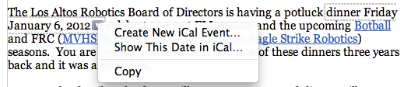
Low-level information extraction
Is now available – and I think popular – in applications like Apple or Google mail, and web indexing
Often seems to be based on regular expressions and name lists
Notes:
low-level information extraction:
mail programs extracting times, dates, phone numbers, events
these are specialized kinds of relations
done using regular expressions

Slide 5
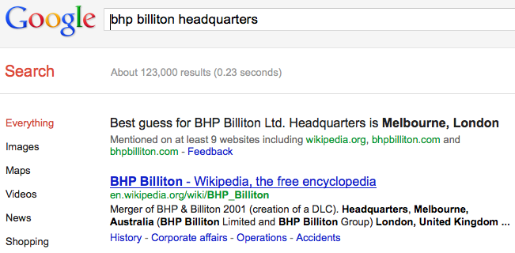
Low-level information extraction
Notes:
low-level information extraction:
mail programs extracting times, dates, phone numbers, events
these are specialized kinds of relations
done using regular expressions

Slide 6
Named Entity Recognition (NER)
A very important sub-task: find and classify names in text, for example:
The decision by the independent MP Andrew Wilkie to withdraw his support for the minority Labor government sounded dramatic but it should not further threaten its stability. When, after the 2010 election, Wilkie, Rob Oakeshott, Tony Windsor and the Greens agreed to support Labor, they gave just two guarantees: confidence and supply.
Notes:
so let's talk a bit more about NER and how it's evaluated, and then we'll talk about two approaches for doing it
so I already defined NER. you have a piece of text, and you want to:
1. find things that are names: European Commission, John Lloyd Jones, etc.
2. give them labels: ORG, PERS, etc.
note that in this particular example "Thursday" was not labeled

Slide 7
Named Entity Recognition (NER)
A very important sub-task: find and classify names in text, for example:
The decision by the independent MP Andrew Wilkie to withdraw his support for the minority Labor government sounded dramatic but it should not further threaten its stability. When, after the 2010 election, Wilkie, Rob Oakeshott, Tony Windsor and the Greens agreed to support Labor, they gave just two guarantees: confidence and supply.
Notes:
An entity is a discrete thing like “IBM Corporation”
But often extended in practice to things like dates, instances of products and chemical/biological substances that aren’t really entities…
“Named” means called “IBM” or “Big Blue” not “it” or “the company”
But also used for times, dates, proteins, etc., which aren’t entities – easy to recognize semantic classes
so let's talk a bit more about NER and how it's evaluated, and then we'll talk about two approaches for doing it
so I already defined NER. you have a piece of text, and you want to:
1. find things that are names: European Commission, John Lloyd Jones, etc.
2. give them labels: ORG, PERS, etc.
note that in this particular example "Thursday" was not labeled

Slide 8
Named Entity Recognition (NER)
A very important sub-task: find and classify names in text, for example:
The decision by the independent MP Andrew Wilkie to withdraw his support for the minority Labor government sounded dramatic but it should not further threaten its stability. When, after the 2010 election, Wilkie, Rob Oakeshott, Tony Windsor and the Greens agreed to support Labor, they gave just two guarantees: confidence and supply.
Person
Date
Location
Organi-
zation
Notes:
Say how this is often a very large part of IE – knowing entity types takes you a long way in IE. Biomedical example.
so let's talk a bit more about NER and how it's evaluated, and then we'll talk about two approaches for doing it
so I already defined NER. you have a piece of text, and you want to:
1. find things that are names: European Commission, John Lloyd Jones, etc.
2. give them labels: ORG, PERS, etc.
note that in this particular example "Thursday" was not labeled

Slide 9
Named Entity Recognition (NER)
The uses:
Named entities can be indexed, linked off, etc.
Sentiment can be attributed to companies or products
A lot of IE relations are associations between named entities
For question answering, answers are often named entities.
Concretely:
Many web pages tag various entities, with links to bio or topic pages, etc.
Reuters’ OpenCalais, Evri, AlchemyAPI, Yahoo’s Term Extraction, …
Apple/Google/Microsoft/… smart recognizers for document content
Notes:
First, let's define NER!
go through pages, recognize the names of things: "Bill MacCartney", "Stanford University"
the people who came up with this task had a rather precise, philosophically motivated meaning in mind
entity: a discrete, actual thing: Bill MacCartney, but not calcium carbonate or Tuesday or Viagra
named entity: an entity with a name, in a philosophical, Kripke-like sense
(this water bottle is an entity, but not a NAMED entity)
but in practice the definition has been expanded quite a bit in later work
we routinely include dates & times, proteins, drug names
but still, loosely, things that have a name
but NOT references to entities which are not names: "this university", "it”
first task in NER: identifying occurrences of named entities
looking for capital letters is a really good clue! at least in English! but not so much in Hebrew, Chinese, ... non-Latinate alphabets also doesn't really work in German -- all nouns are capitalized!
so that's a pretty useful base-level task -- widely deployed and used
you've probably seen web pages that do this
e.g. financial web sites often mark up stock symbols, names of companies
Microsoft has done work with this, smart tags, entities tagged with metadata
Reuters has web service OpenCalais, you send them docs, they send back NER markup

Slide 10
Information Extraction and Named Entity Recognition
Introducing the tasks:
Getting simple structured information out of text

